Slide 1
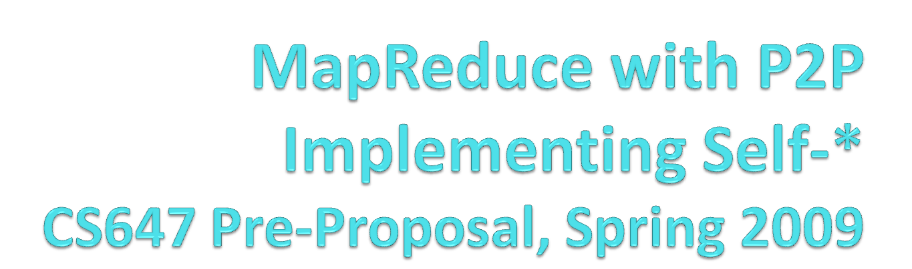
Omar Badran
Jordan Osecki
Bill Shaya

Slide 2
Each group will carry out an extensive presentation of their work and its results at the
very end of the term. The presentation should be well-organized, clear and exhaustive. It
should aim at being engaging for the class, and stimulate discussion about your work.
Demoing of your system as part of the presentation is highly encouraged.
For team projects, I expect all members of a team to be equally able to present, discuss
and answer questions about all aspects of their project.

Slide 3
Research Area
Exploring the MapReduce and P2P technologies and how they can be combined
There are multiple Self-* issues that can be addressed to make this type of distributed system more efficient
  Issues regarding how to make a P2P system perform MapReduce
  Issues regarding if nodes perform horribly compared to their peer Worker nodes
  Issues regarding if nodes (Masters or Workers) fail completely, not performing their workload

Slide 4
Problems and Interests
When the MapReduce system is running on a P2P network, issues regarding how the mapping and reducing occur
  How will the jobs be distributed out and then re-combined?
When the work is split up between multiple nodes, only as good as the weakest link
  How can we analyze this to make tasks resilient to slower nodes?
When nodes go down, their work is lost, which can cause a huge delay
  How can these nodes be watched to ensure if they fail, the delay time is not catastrophic? How do we handle a Worker versus a Master failing?

Slide 5
Relevant Work and Technologies
Hadoop – Apache Java software framework
Skynet – Ruby MapReduce framework
Problems
  Centralized command and control could be dangerous
    If Master goes down, system fails
  If certain nodes fail, priority needed to re-assign jobs
Solutions
  Dynamic masters
  Scheduler that steps in if Master or Workers fail or slow

Slide 6
Self Adaptation Solutions
Self Configuration:
  One node assumes the role of the Master
  Determines and distributes the number of mapper and reducer tasks
Self Healing:
  Monitor nodes
  If Master fails, another peer takes over as Master
  If Worker fails or runs poorly, reallocation of computation
  Seamless completion despite failures

Slide 7
Implementation Solution Overview
Create a Java console application
Simulation of MapReduce system on a P2P-type network to count the number of words in a file
Configurable system parameters to influence system behavior
Simulate various scenarios such as faults, master failure, etc. to exercise self adaptation

Slide 8
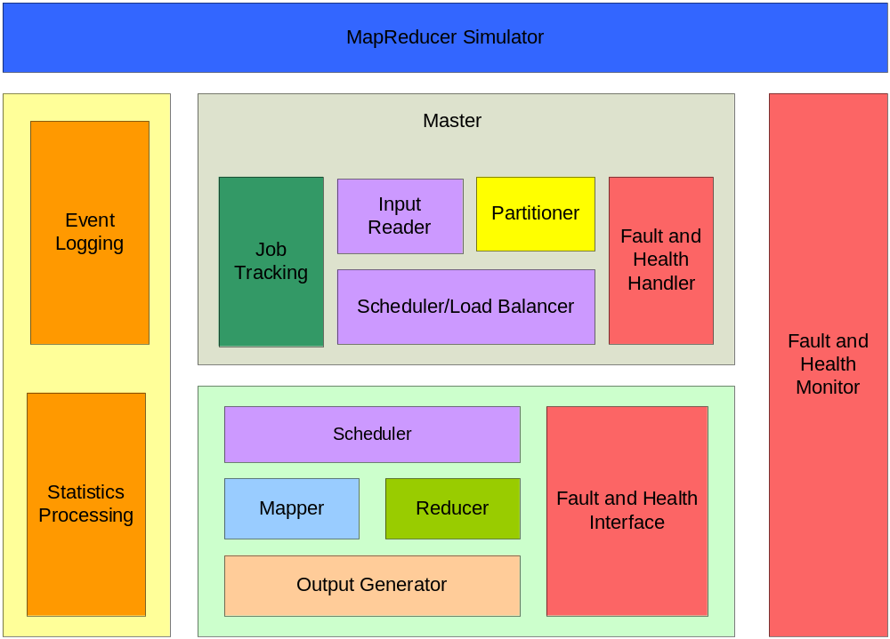
Implementation Block Diagram

Slide 9
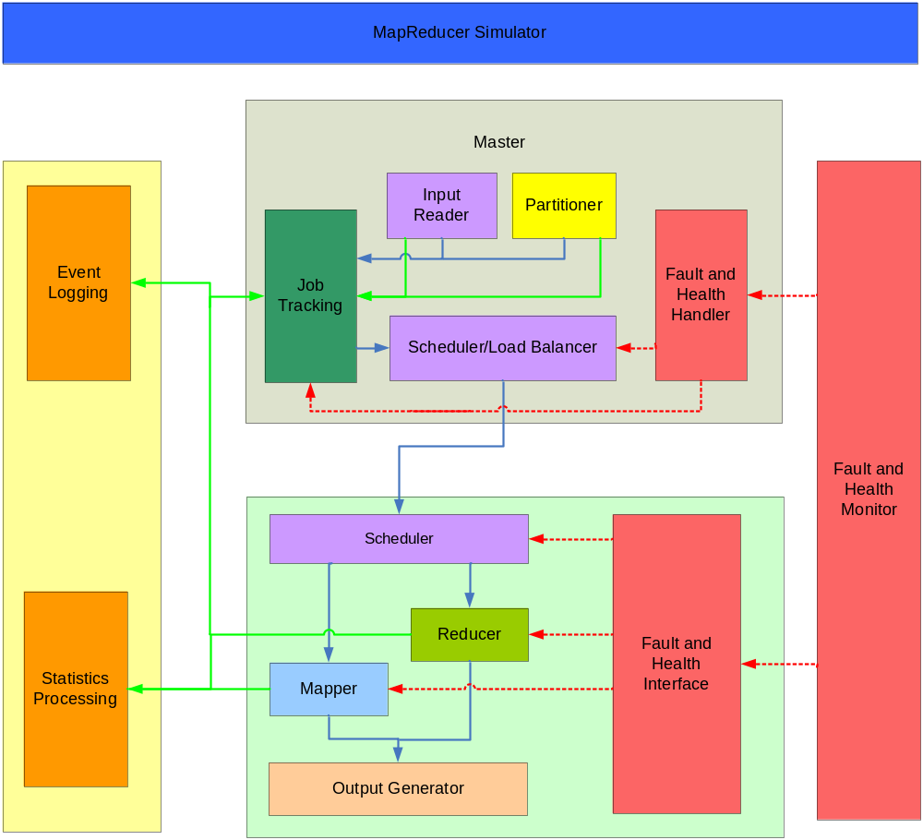
Implementation Flow Block Diagram

